Slide 1
SC2005 Operating Systems
2024/2025 Second Semester
Arvind Easwaran
Cai Wentong
{arvinde, aswtcai}@ntu.edu.sg
This presentation adopts the slides by Prof. Edouard Bugnion (EPFL), the co-founder of VMware
Notes:
The lecture is divided into two parts. The first part is given by me; the second part will be given by Prof. Cai Wentong. The best way of contacting us is via email. You can get the detailed contact information about Prof. Cai and me on the school website.

Slide 2
Virtualization Landscape
CPU
Process abstraction and API
Infinite
processor
Scheduling
Concurrency
Basic concurrency primitives
Multi-core
processor
Correct concurrent programming
Persistence
IO devices
Storage manager
File systems (after recess week)
Memory
Virtual memory
(after recess week)
Infinite
memory
Segmentation and paging
(after recess week)

Slide 3
Outline
Virtualization fundamentals
Definition
Multiplexing
Aggregation
Emulation
Virtual machines (VMs)
Definition & history (Popek & Goldberg)
VMM Construction
Virtual CPU

Slide 4
Virtualization Fundamentals

Slide 5

Principle of indirection
Any problem in computer science can be solved by adding a level of indirection. But this usually creates another problem.
David Wheeler
Virtualization applies indirection through layering when the layered abstraction is compatible with the layer it relies upon

Slide 6
Why CPU virtualization?
Recall: OS processes share CPU cores
CPU core can be allocated to a process for a time slot
Reasons for CPU cores virtualization
To share physical CPU resources among multiple VMs
Recall: Multiprogramming improves resource efficiency
Isolation of workloads for security and performance
Example: Cloud servers can run 10s-1000s customers’ jobs
Multiple operating systems to run on the same hardware.

Slide 7
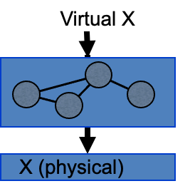
Layered & Compatible
Layer that exports a compatible abstraction of the layer that it relies on
Hiding the physical names from the abstraction to ensure isolation
Virtualization enforces modularity
Applies to different types of resources
Notably CPU, disks, memory

Slide 8
3 main virtualization mechanisms
Virtualization by multiplexing
Expose a single resource among multiple virtual entities
E.g., CPU, memory
Virtualization by aggregation
Make multiple resources appear as one single virtual resource
E.g., disk volumes
Virtualization by emulation
Make a physical resource appear as another physical resources
E.g., a serial port over a USB port, or over SSH

Slide 9

Check Your Understanding
Keep Wooclap open on your device before the lecture ends

Slide 10
Virtualization via Multiplexing
Virtual CPU cores (vCPUs) and scheduling
Each physical CPU core can run any vCPU
Multiplexing: The host OS schedules vCPUs to runs on CPU cores
Example: Linux treats vCPUs as processes
Each virtual machine’s (VM) guest OS can schedule its processes on vCPUs
Similarly to a non-virtualized OS
Example scenarios
4-core server can run 4 single-vCPU VMs
4-core server can run 8 2-vCPU VMs (CPU overcommitment)
Assumption: Not all VMs have running processes simultaneously

Slide 11
Aggregation: many appear as one

Slide 12
Primary use: aggregating physical resources
Recall from Comp. Arch.: A computer has multiple MMs (memory modules)
The memory controller aggregates the physical memory into a single (typically contiguous) namespace
A computer has many hard drives
RAID (Redundant Array of Inexpensive Disks) make them appear as a single volume
With additional features (see next slide)
A network has multiple links connecting servers
Link aggregation and multipathing create a virtual link with more bandwidth

Slide 13
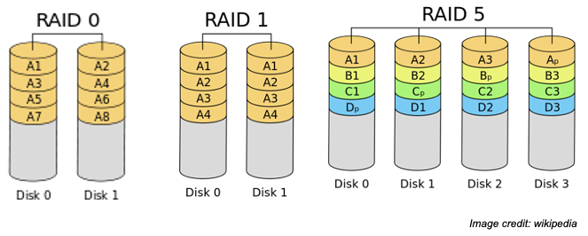
RAID: aggregating physical disks into volumes

Slide 14
Layered & Compatible : volume of sectors
Aggregate n disks into 1 volume
P = disk with N sectors
V = disk with M sectors

Slide 15
RAID: aggregating physical disks into volumes
Striping
Mirroring
Distributed Parity encoding
M = N * n
M = N;n=2
M = N * (n-1) ; n>=3

Slide 16
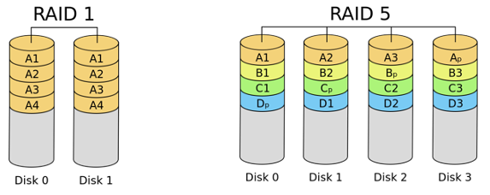
So, which is better ?
A: (hint:) there is nearly always a trade-off in computer systems.

Slide 17
Emulation

Slide 18
Virtualization via emulation
Sometimes there is no physical X, or a different physical X in the same category
Category: CPU of a given architecture, block storage, Ethernet NIC, etc.
Idea: use software to emulate a resource different from the underlying resource
Expose it within the OS as a virtual resource
Software

Slide 19
Virtualization via emulation
Examples:
A RAM disk: P=DRAM, V=disk to mount a filesystem (/tmp)
A Java Virtual Machine: P=x86-64 or Arm CPU; V=Java byte code processor
Apple Rosetta - dynamic cross-architectural translation
P = x86-64 core; V = PowerPC processor (in 2006)
P = Arm v8; V = x86-64 processor (in 2020)
127.0.0.1 (localhost interface)
P = <none>; V = a virtual ethernet interface (to if-up IPv4 localhost)

Slide 20
Putting it all together:
Virtual Machines

Slide 21
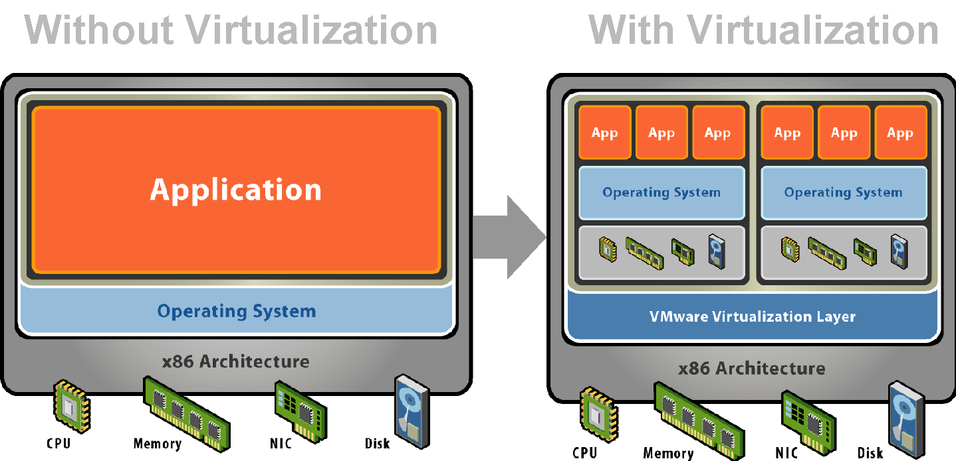
Virtual Machines
Apply virtualization principle to an entire computer system
P = computer system
V = computer system (== virtual machine)

Slide 22
Why virtual machines ?
Very popular in the very early days of computing (60’s, 70’s)
Hardware was expensive
Operating systems were primitive (pre-MULTICS)
Back in favor since 2000
To ensure compatibility with the OS of choice
To consolidate servers
As a foundation for multi-tenancy (different owners)
Because it is easy to provision a VM than a real machine
…. And therefore, as the foundation of the cloud

Slide 23
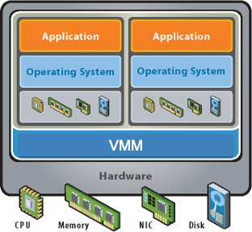
Virtual Machines - Def. by Popek and Goldberg [1974]
A virtual machine is an efficient, isolated duplicate of the real machine
The virtual machine monitor (or hypervisor)
Is always in complete control of the system
Uses the hardware directly so that programs show at most a minor decrease in speed

Slide 24
Virtual Machines - Terminology
Operating systems
Guest operating system : running inside a virtual machine
Host operating system: running directly on the hardware - combined with the VMM
E.g., Linux with KVM
Memory
Virtual memory -- as commonly understood
Guest physical memory -- physical memory of the VM
Host physical memory -- (actual) physical memory

Slide 25

Check Your Understanding
Keep Wooclap open on your device before the lecture ends

Slide 26
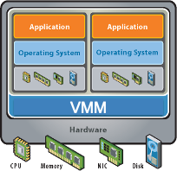
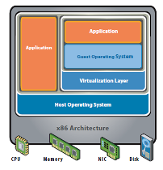
Type 1 vs. Type 2
Type 1
VMM is also the host OS
E.g., Xen, vSphere
Type 2
VMM optional extension to the host OS
E.g. KVM and Linux

Slide 27
Virtualization Levels
Full virtualization
Complete abstraction of the actual hardware
Guest OS runs unmodified on the hypervisor
It is unaware of the hypervisor’s existence
Examples: VMware ESXi, Microsoft Virtual Server
Para-virtualization
Unique software interface (API) between guest OS & VM
Guest OS needs to be modified to adapt to the new API
Advantage: VM does not virtualize hard-to-implement parts of the H/W instruction set, hence more efficient
Examples: Xen, VMware, XtratuM
Notes:
Orthogonal to virtualization types, we have virtualization level, which denotes the extent to which hardware is virtualized by the hypervisor.
In full virtualization, the hardware is completely abstracted, meaning the guest OS is not aware of the existence of hypervisor. The advantage of this is that any existing OS can be used as a guest OS off-the-shelf.
Full virtualization is slow however, because some H/W instructions are hard to virtualize. An alternate to this is para-virtualization, where the hard-to-virtualize parts of the instruction set are left untouched and handled only by the hypervisor. This means the guest OS must now be modified to interact with the hypervisor, because some services and features are not available at the guest OS level.

Slide 28
Check Your Understanding
Keep Wooclap open on your device before the lecture ends

Slide 29
Check Your Understanding
Keep Wooclap open on your device before the lecture ends

Slide 30
Constructing a VMM
P = computer system
V = computer system (== virtual machine)

Slide 31
VMM multiplex and emulate
Multiplex CPU and memory, with hardware support
Each VM has its own virtual CPUs (=virtual core)
P=core; V=core
Requires system-level limited direct execution
Each VM has its own guest physical memory
P=physical memory; V=physical memory
Requires hardware support for virtual memory mechanisms (details after the recess week)
Emulate I/O devices
Virtual disk, virtual keyboard, virtual screen, virtual NIC, virtual Ethernet switch, etc.

Slide 32
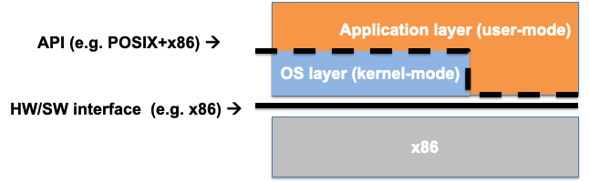
Bare-metal system -- limited direct execution
Key observations:
Application executes unprivileged instructions directly on CPU
Application make system calls to the OS (--> kernel mode)
Privileged instructions are restricted to OS (trap from user mode)
This slide is not examinable

Slide 33
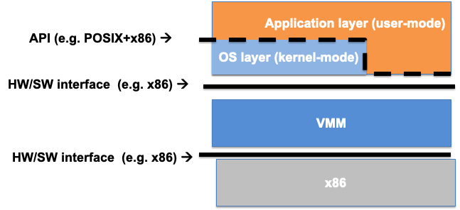
Adding a level of indirection
Key observations:
Virtual CPU == virtualize HW/SW interface (e.g. x86-64)
Standard virtualization trick -- expose the same abstraction V as the underlying resource P and everything else will still work
This slide is not examinable

Slide 34
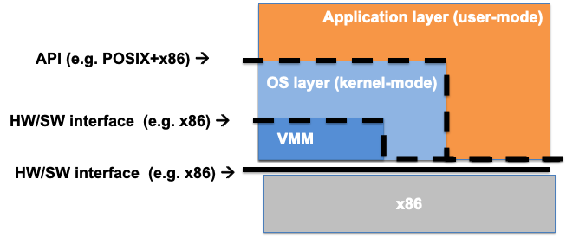
System-level limited direct execution
Essential for efficiency:
Application and guest OS use the CPU directly
Trap (some) privileged instructions issued by guest OS
This slide is not examinable

Slide 35
Virtual CPU -- recap
Multiplexed in space and time -- very much like kernel threads
Space: VMM schedules vCPU from different VMs on different core
Time: VMM schedules multiple vCPUs on a limited set of physical cores
Isolation guaranteed via:
Non-root mode execution of the VM
Host OS / VMM is presumed to be correct (very much like the OS)
Basic mechanism : limited direct execution
Same idea as with protected operating system
Extended here from application-only to system-level
This slide is not examinable

Slide 36
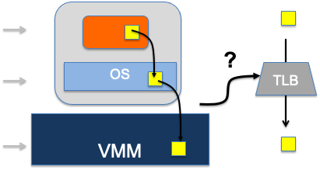
Virtualizing physical memory
Virtual address (VA)
Guest-physical address (GPA)
Host-physical address (HPA)
Memory address translation
Processors use VA
TLB stores mapping between VA and HPA
This slide is not examinable
This slide is not examinable

Slide 37
Check Your Understanding
Keep Wooclap open on your device before the lecture ends

Slide 38
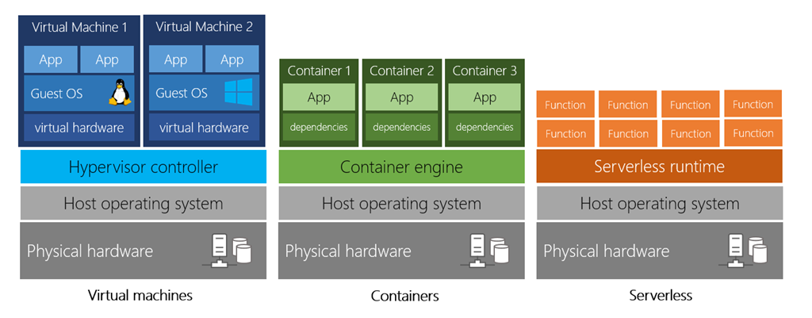
Modern Virtualization Landscape
This slide is not examinable

Slide 39
Emerging Virtualization Landscape
Generative AI as a service is booming
Examples: ChatGPT, Perplexity, Anthropic, Gemini, …
Problem: Requires large GPUs clusters -> costly & power hungry
Virtualization is essential to make GenAI feasible at scale
Emulation: Virtual GPU vs. physical GPU
Multiplexing: GPU memory sharing by many AI models
Aggregation: Deploy a model on several GPUs at once
This slide is not examinable

